Slide 1
Software Cost Estimation
Professor Mike Hinchey

Slide 2
Software cost estimation
Predicting the resources required for a software development process

Slide 3
Objectives
To introduce the fundamentals of software costing and pricing
To describe three metrics for software productivity assessment
To explain why different techniques should be used for software estimation
To describe the COCOMO 2 algorithmic cost estimation model

Slide 4
Topics covered
Productivity
Estimation techniques
Algorithmic cost modelling
Project duration and staffing

Slide 5
Fundamental estimation questions
How much effort is required to complete an activity?
How much calendar time is needed to complete an activity?
What is the total cost of an activity?
Project estimation and scheduling and interleaved management activities

Slide 6
Software cost components
Hardware and software costs
Travel and training costs
Effort costs (the dominant factor in most projects)
salaries of engineers involved in the project
Social and insurance costs
Effort costs must take overheads into account
costs of building, heating, lighting
costs of networking and communications
costs of shared facilities (e.g library, staff restaurant, etc.)

Slide 7
Costing and pricing
Estimates are made to discover the cost, to the developer, of producing a software system
There is not a simple relationship between the development cost and the price charged to the customer
Broader organisational, economic, political and business considerations influence the price charged

Slide 8
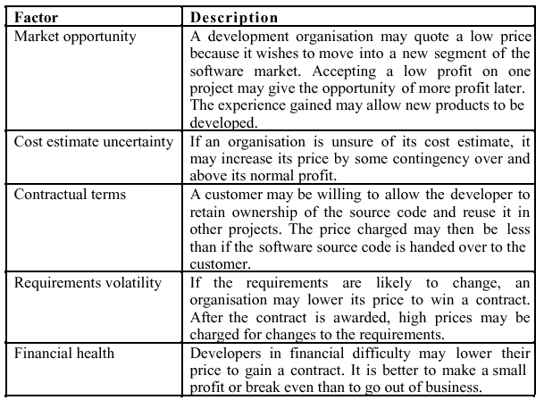
Software pricing factors

Slide 9
Programmer productivity
A measure of the rate at which individual engineers involved in software development produce software and associated documentation
Not quality-oriented although quality assurance is a factor in productivity assessment
Essentially, we want to measure useful functionality produced per time unit

Slide 10
Productivity measures
Size related measures based on some output from the software process. This may be lines of delivered source code, object code instructions, etc.
Function-related measures based on an estimate of the functionality of the delivered software. Function-points are the best known of this type of measure

Slide 11
Measurement problems
Estimating the size of the measure
Estimating the total number of programmer months which have elapsed
Estimating contractor productivity (e.g., documentation team) and incorporating this estimate in overall estimate

Slide 12
Lines of code
What's a line of code?
The measure was first proposed when programs were typed on cards with one line per card
How does this correspond to statements as in Java which can span several lines or where there can be several statements on one line
What programs should be counted as part of the system?
Assumes linear relationship between system size and volume of documentation

Slide 13
Productivity comparisons
The lower level the language, the more productive the programmer
The same functionality takes more code to implement in a lower-level language than in a high-level language
The more verbose the programmer, the higher the productivity
Measures of productivity based on lines of code suggest that programmers who write verbose code are more productive than programmers who write compact code

Slide 14
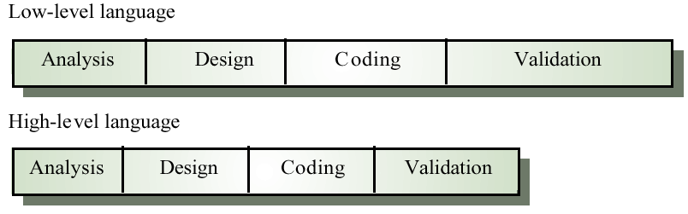
High and low level languages

Slide 15
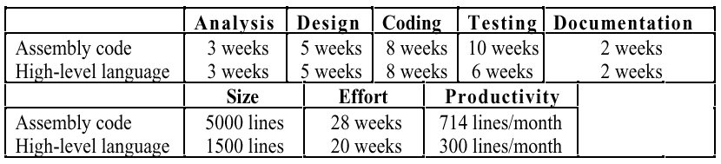
System development times

Slide 16
Function points
Based on a combination of program characteristics
external inputs and outputs
user interactions
external interfaces
files used by the system
A weight is associated with each of these
The function point count is computed by multiplying each raw count by the weight and summing all values

Slide 17
Function points
Function point count modified by complexity of the project
FPs can be used to estimate LOC depending on the average number of LOC per FP for a given language
LOC = AVC * number of function points
AVC is a language-dependent factor varying from 200-300 for assemble language to 2-40 for a 4GL
FPs are very subjective. They depend on the estimator.
Automatic function-point counting is impossible

Slide 18
Object points
Object points are an alternative function-related measure to function points when 4Gls or similar languages are used for development
Object points are NOT the same as object classes
The number of object points in a program is a weighted estimate of
The number of separate screens that are displayed
The number of reports that are produced by the system
The number of 3GL modules that must be developed to supplement the 4GL code

Slide 19
Object point estimation
Object points are easier to estimate from a specification than function points as they are simply concerned with screens, reports and 3GL modules
They can therefore be estimated at an early point in the development process. At this stage, it is very difficult to estimate the number of lines of code in a system

Slide 20
Productivity estimates
Real-time embedded systems, 40-160 LOC/P-month
Systems programs , 150-400 LOC/P-month
Commercial applications, 200-800 LOC/P-month
In object points, productivity has been measured between 4 and 50 object points/month depending on tool support and developer capability

Slide 21
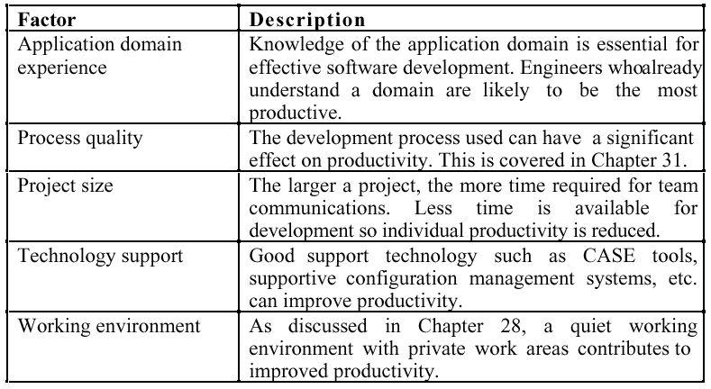
Factors affecting productivity

Slide 22
Quality and productivity
All metrics based on volume/unit time are flawed because they do not take quality into account
Productivity may generally be increased at the cost of quality
It is not clear how productivity/quality metrics are related
If change is constant then an approach based on counting lines of code is not meaningful

Slide 23
Estimation techniques
There is no simple way to make an accurate estimate of the effort required to develop a software system
Initial estimates are based on inadequate information in a user requirements definition
The software may run on unfamiliar computers or use new technology
The people in the project may be unknown
Project cost estimates may be self-fulfilling
The estimate defines the budget and the product is adjusted to meet the budget

Slide 24
Estimation techniques
Algorithmic cost modelling
Expert judgement
Estimation by analogy
Parkinson's Law
Pricing to win

Slide 25
Algorithmic code modelling
A formulaic approach based on historical cost information and which is generally based on the size of the software

Slide 26
Expert judgement
One or more experts in both software development and the application domain use their experience to predict software costs. Process iterates until some consensus is reached.
Advantages: Relatively cheap estimation method. Can be accurate if experts have direct experience of similar systems
Disadvantages: Very inaccurate if there are no experts!

Slide 27
Estimation by analogy
The cost of a project is computed by comparing the project to a similar project in the same application domain
Advantages: Accurate if project data available
Disadvantages: Impossible if no comparable project has been tackled. Needs systematically maintained cost database

Slide 28
Parkinson's Law
The project costs whatever resources are available
Advantages: No overspend
Disadvantages: System is usually unfinished

Slide 29
Pricing to win
The project costs whatever the customer has to spend on it
Advantages: You get the contract
Disadvantages: The probability that the customer gets the system he or she wants is small. Costs do not accurately reflect the work required

Slide 30
Top-down and bottom-up estimation
Any of these approaches may be used top-down or bottom-up
Top-down
Start at the system level and assess the overall system functionality and how this is delivered through sub-systems
Bottom-up
Start at the component level and estimate the effort required for each component. Add these efforts to reach a final estimate

Slide 31
Top-down estimation
Usable without knowledge of the system architecture and the components that might be part of the system
Takes into account costs such as integration, configuration management and documentation
Can underestimate the cost of solving difficult low-level technical problems

Slide 32
Bottom-up estimation
Usable when the architecture of the system is known and components identified
Accurate method if the system has been designed in detail
May underestimate costs of system level activities such as integration and documentation

Slide 33
Estimation methods
Each method has strengths and weaknesses
Estimation should be based on several methods
If these do not return approximately the same result, there is insufficient information available
Some action should be taken to find out more in order to make more accurate estimates
Pricing to win is sometimes the only applicable method

Slide 34
Experience-based estimates
Estimating is primarily experience-based
However, new methods and technologies may make estimating based on experience inaccurate
Object oriented rather than function-oriented development
Client-server systems rather than mainframe systems
Off the shelf components
Component-based software engineering
CASE tools and program generators

Slide 35
Pricing to win
This approach may seem unethical and unbusinesslike
However, when detailed information is lacking it may be the only appropriate strategy
The project cost is agreed on the basis of an outline proposal and the development is constrained by that cost
A detailed specification may be negotiated or an evolutionary approach used for system development

Slide 36
Algorithmic cost modelling
Cost is estimated as a mathematical function of product, project and process attributes whose values are estimated by project managers
Effort = A × Size^{B} × M
A is an organisation-dependent constant, B reflects the disproportionate effort for large projects and M is a multiplier reflecting product, process and people attributes
Most commonly used product attribute for cost estimation is code size
Most models are basically similar but with different values for A, B and M

Slide 37
Estimation accuracy
The size of a software system can only be known accurately when it is finished
Several factors influence the final size
Use of COTS and components
Programming language
Distribution of system
As the development process progresses then the size estimate becomes more accurate

Slide 38
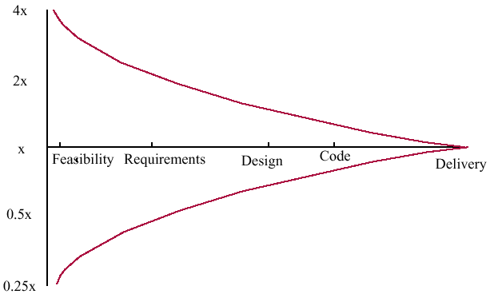
Estimate uncertainty

Slide 39
The COCOMO model
An empirical model based on project experience
Well-documented, ‘independent’ model which is not tied to a specific software vendor
Long history from initial version published in 1981 (COCOMO-81) through various instantiations to COCOMO 2
COCOMO 2 takes into account different approaches to software development, reuse, etc.

Slide 40
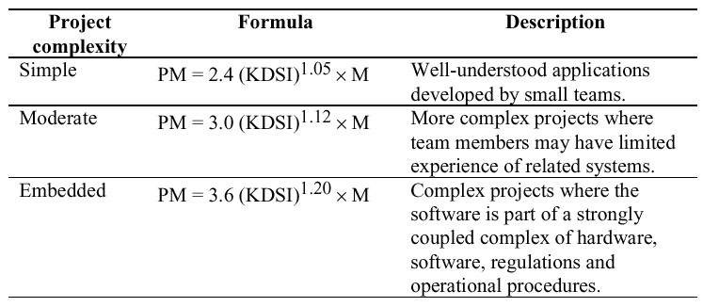
COCOMO 81

Slide 41
COCOMO 2 levels
COCOMO 2 is a 3 level model that allows increasingly detailed estimates to be prepared as development progresses
Early prototyping level
Estimates based on object points and a simple formula is used for effort estimation
Early design level
Estimates based on function points that are then translated to LOC
Post-architecture level
Estimates based on lines of source code

Slide 42
Early prototyping level
Supports prototyping projects and projects where there is extensive reuse
Based on standard estimates of developer productivity in object points/month
Takes CASE tool use into account
Formula is
PM = ( NOP × (1 - %reuse/100 ) ) / PROD
PM is the effort in person-months, NOP is the number of object points and PROD is the productivity

Slide 43
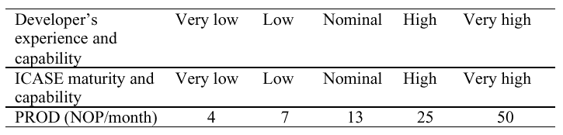
Object point productivity

Slide 44
Early design level
Estimates can be made after the requirements have been agreed
Based on standard formula for algorithmic models
PM = A × Size^{B} × M + PM_{m} where
M = PERS × RCPX × RUSE × PDIF × PREX × FCIL × SCED
PM_{m} = (ASLOC × (AT/100)) / ATPROD
A = 2.5 in initial calibration, Size in KLOC, B varies from 1.1 to 1.24 depending on novelty of the project, development flexibility, risk management approaches and the process maturity

Slide 45
Multipliers
Multipliers reflect the capability of the developers, the non-functional requirements, the familiarity with the development platform, etc.
RCPX - product reliability and complexity
RUSE - the reuse required
PDIF - platform difficulty
PREX - personnel experience
PERS - personnel capability
SCED - required schedule
FCIL - the team support facilities
PM reflects the amount of automatically generated code

Slide 46
Post-architecture level
Uses same formula as early design estimates
Estimate of size is adjusted to take into account
Requirements volatility. Rework required to support change
Extent of possible reuse. Reuse is non-linear and has associated costs so this is not a simple reduction in LOC
ESLOC = ASLOC × (AA + SU +0.4DM + 0.3CM +0.3IM)/100
ESLOC is equivalent number of lines of new code. ASLOC is the number of lines of reusable code which must be modified, DM is the percentage of design modified, CM is the percentage of the code that is modified , IM is the percentage of the original integration effort required for integrating the reused software.
SU is a factor based on the cost of software understanding, AA is a factor which reflects the initial assessment costs of deciding if software may be reused.

Slide 47
The exponent term
This depends on 5 scale factors (see next slide). Their sum/100 is added to 1.01
Example
Precedenteness - new project - 4
Development flexibility - no client involvement - Very high - 1
Architecture/risk resolution - No risk analysis - V. Low - 5
Team cohesion - new team - nominal - 3
Process maturity - some control - nominal - 3
Scale factor is therefore 1.17

Slide 48
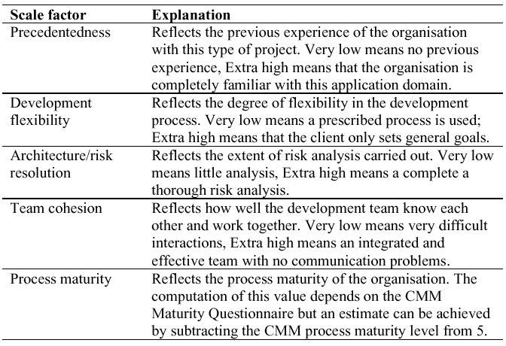
Exponent scale factors

Slide 49
Multipliers
Product attributes
concerned with required characteristics of the software product being developed
Computer attributes
constraints imposed on the software by the hardware platform
Personnel attributes
multipliers that take the experience and capabilities of the people working on the project into account.
Project attributes
concerned with the particular characteristics of the software development project

Slide 50
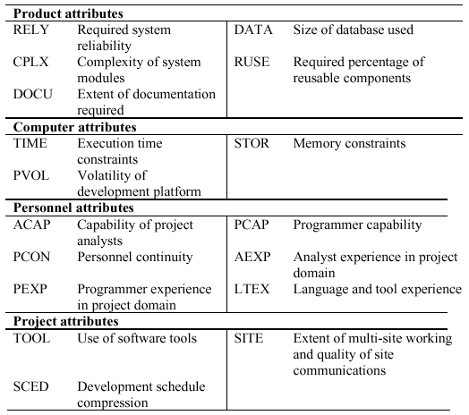
Project cost drivers

Slide 51
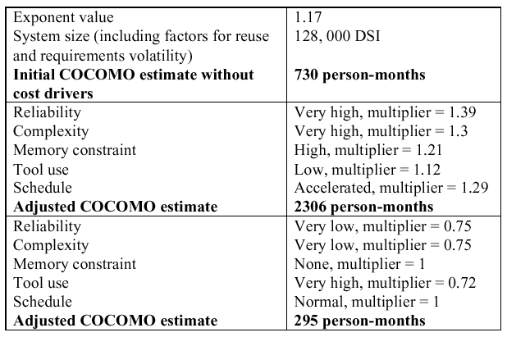
Effects of cost drivers

Slide 52
Project planning
Algorithmic cost models provide a basis for project planning as they allow alternative strategies to be compared
Embedded spacecraft system
Must be reliable
Must minimise weight (number of chips)
Multipliers on reliability and computer constraints > 1
Cost components
Target hardware
Development platform
Effort required

Slide 53
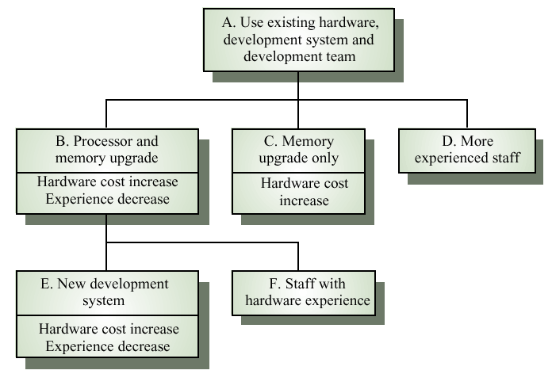
Management options

Slide 54
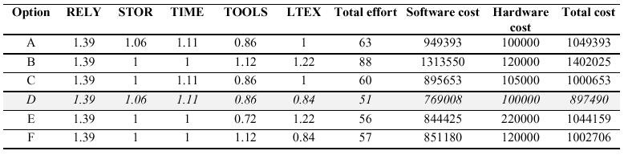
Management options costs

Slide 55
Option choice
Option D (use more experienced staff) appears to be the best alternative
However, it has a high associated risk as experienced staff may be difficult to find
Option C (upgrade memory) has a lower cost saving but very low risk
Overall, the model reveals the importance of staff experience in software development

Slide 56
Project duration and staffing
As well as effort estimation, managers must estimate the calendar time required to complete a project and when staff will be required
Calendar time can be estimated using a COCOMO 2 formula
TDEV = 3 × (PM)^{(0.33+0.2*(B-1.01))}
PM is the effort computation and B is the exponent computed as discussed above (B is 1 for the early prototyping model). This computation predicts the nominal schedule for the project
The time required is independent of the number of people working on the project

Slide 57
Staffing requirements
Staff required can’t be computed by diving the development time by the required schedule
The number of people working on a project varies depending on the phase of the project
The more people who work on the project, the more total effort is usually required
A very rapid build-up of people often correlates with schedule slippage

Slide 58
Key points
Factors affecting productivity include individual aptitude, domain experience, the development project, the project size, tool support and the working environment
Different techniques of cost estimation should be used when estimating costs
Software may be priced to gain a contract and the functionality adjusted to the price

Slide 59
Key points
Algorithmic cost estimation is difficult because of the need to estimate attributes of the finished product
The COCOMO model takes project, product, personnel and hardware attributes into account when predicting effort required
Algorithmic cost models support quantitative option analysis
The time to complete a project is not proportional to the number of people working on the project

Slide 60
Thank you

